Slide 1
Data Modeling
*Uses of Data model
*Types of data model
Presented by: Jagannath Khadka

Slide 2
Data model
Data modeling is the process of creating a visual representation of either a whole information system or parts of it to communicate connections between data points and structures.
It describes the data that flow through the business processes in an organization.

Slide 3
Types of Data Model
Conceptual Data Model: This Data Model defines WHAT the system contains. This model is typically created by Business stakeholders and Data Architects. The purpose is to organize, scope and define business concepts and rules. Logical Data Model: Defines HOW the system should be implemented regardless of the DBMS. This model is typically created by Data Architects and Business Analysts. The purpose is to developed technical map of rules and data structures. Physical Data Model: This Data Model describes HOW the system will be implemented using a specific DBMS system. This model is typically created by DBA and developers. The purpose is actual implementation of the database.

Slide 4
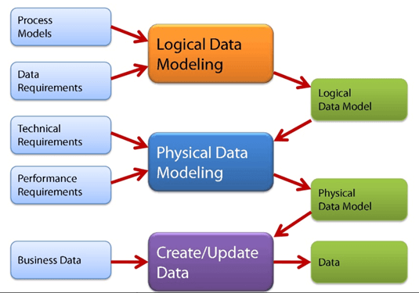

Slide 5
Uses of Data Model
It is helpful to identify missing and redundant data.
Ensures that all data objects required by the database are accurately represented.
They are used to show the data needed and created by business processes.

Slide 6
Benefit of Data Model
Data modeling makes it easier for developers, data architects, business analysts, and other stakeholders to view and understand relationships among the data in a database or data warehouse. In addition, it can:
Reduce errors in software and database development.
Increase consistency in documentation and system design across the enterprise.
Improve application and database performance.
Ease data mapping throughout the organization.
Improve communication between developers and business intelligence teams.

Slide 7
Thank you for joining me today.
Have a great time.

